Slide 1

Cyclistic Bike Share Analysis

Slide 2
About Company and Analysis
Cyclistic, a bike-share company in Chicago provides two types of memberships as causal and annual to the customers, they have two types of bikes docked and electric preferably used by their customers,
Analysis should be done according to the usage pattern of the customers and the most preferred bike type.
This kind of analysis helps to plan the future marketing strategy ans to increase the annual memberships.

Slide 3
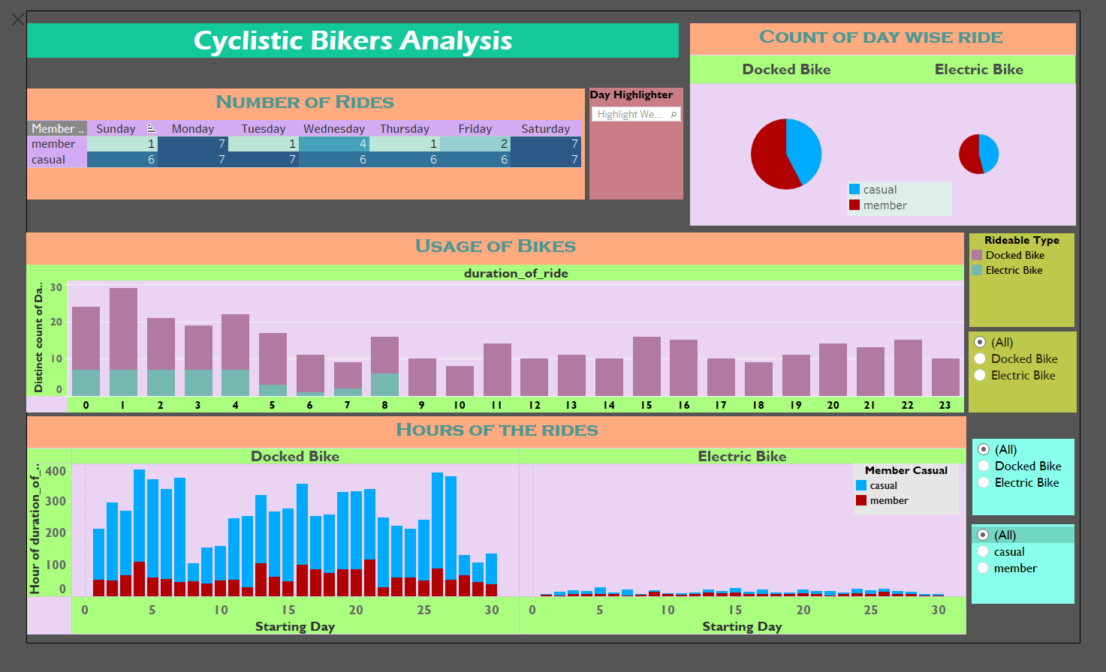
Analysis Dashboard

Slide 4
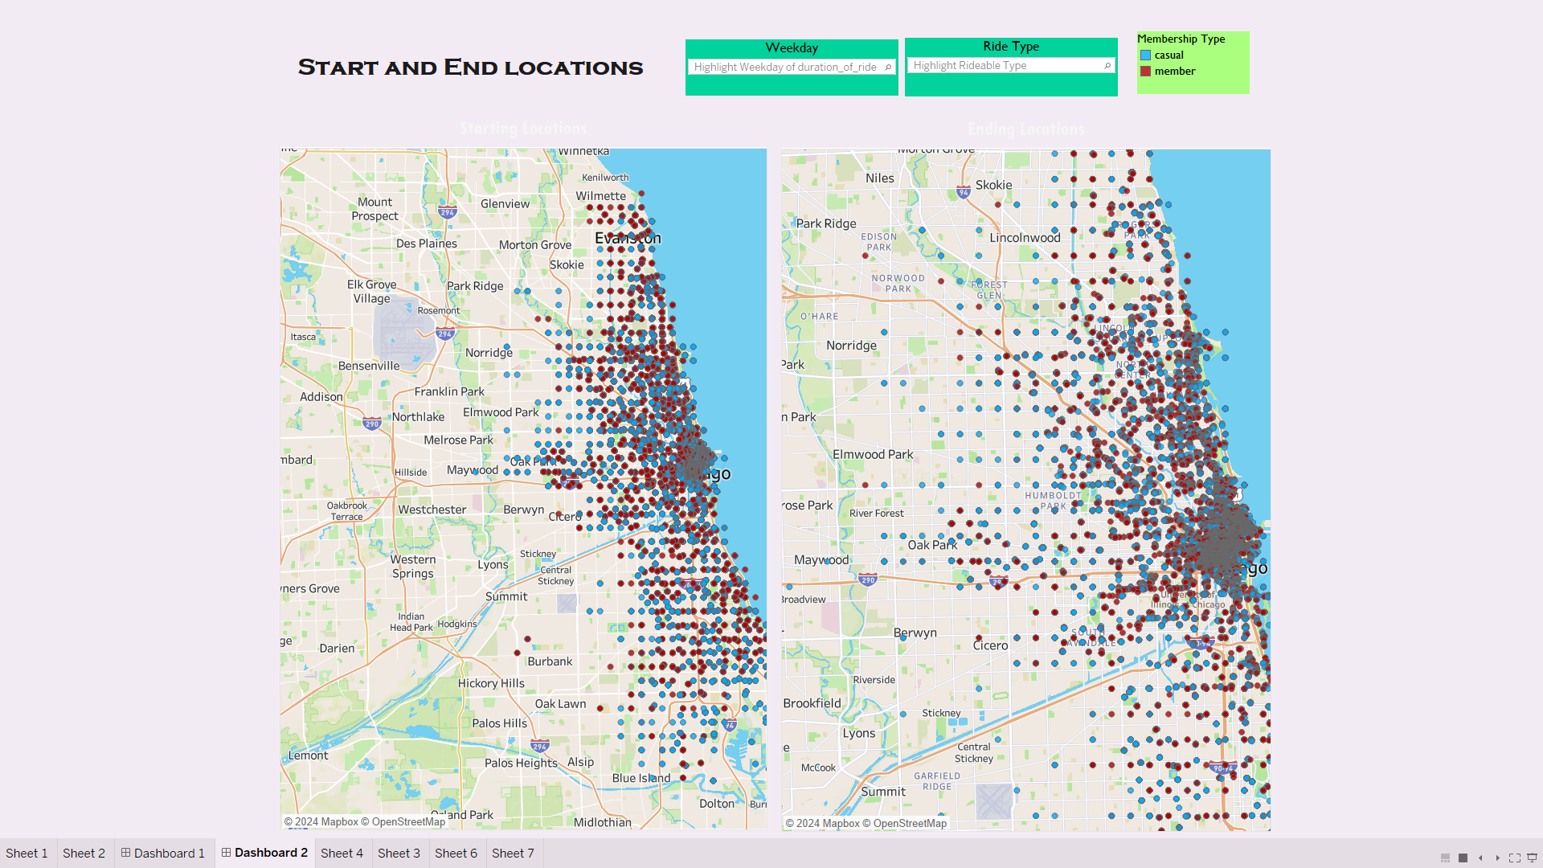
Trip Map Analysis Dashboard

Slide 5
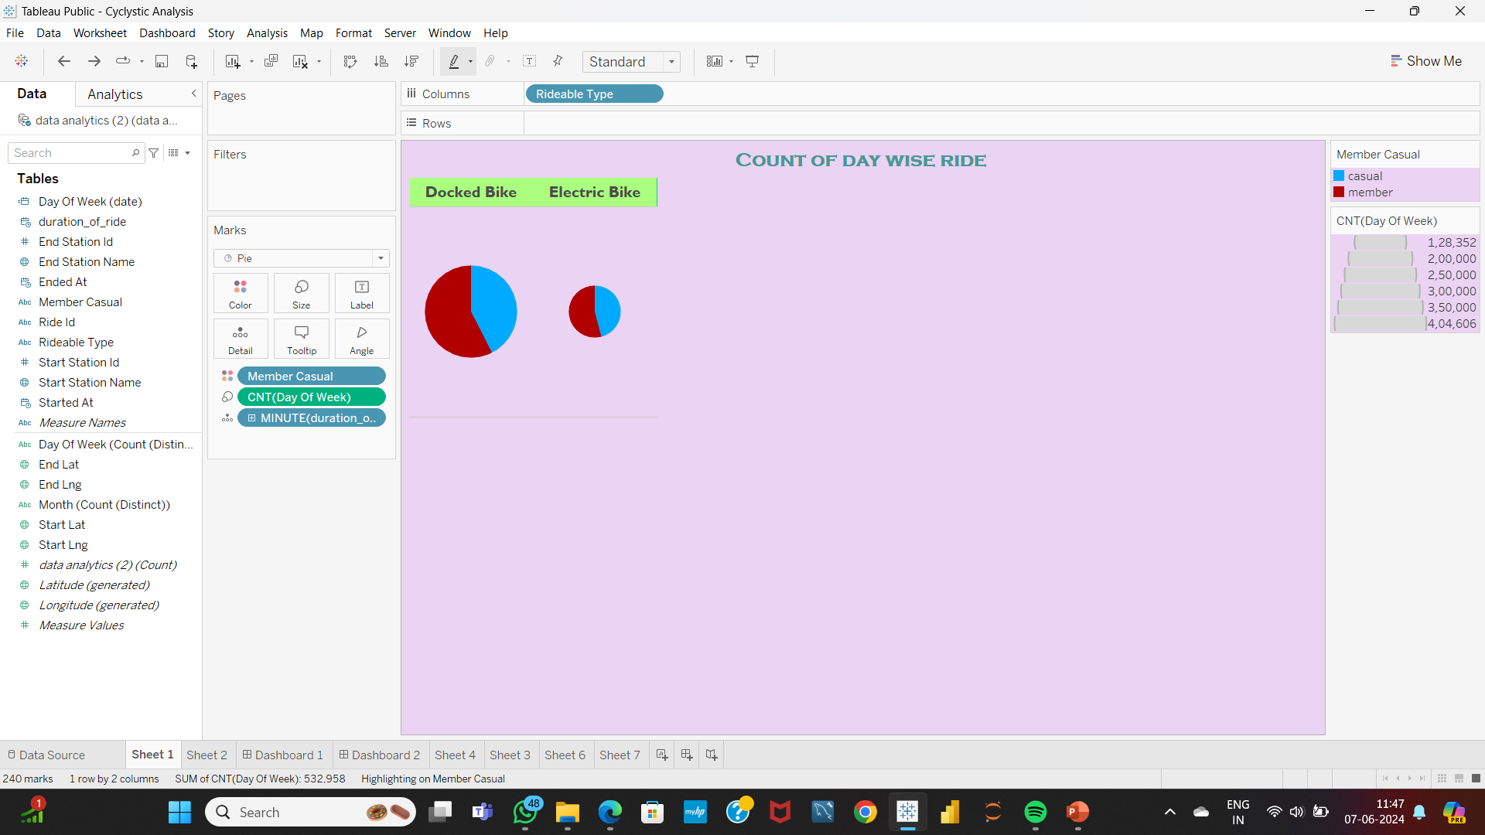
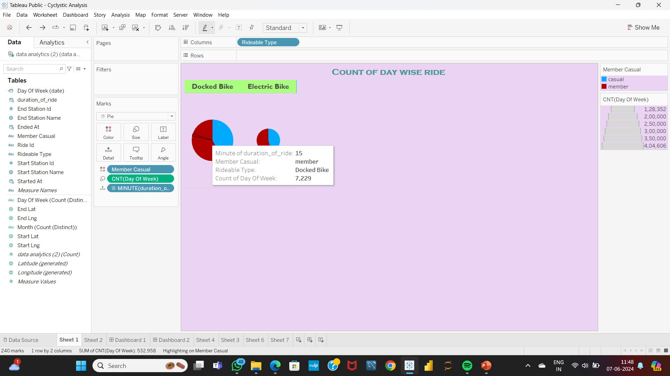
This pie chart visual shows the day wise count of the rides by causal and annual type members. The tooltip information's like minutes of rides, type of bike, type of member and count of the day are included.

Slide 6
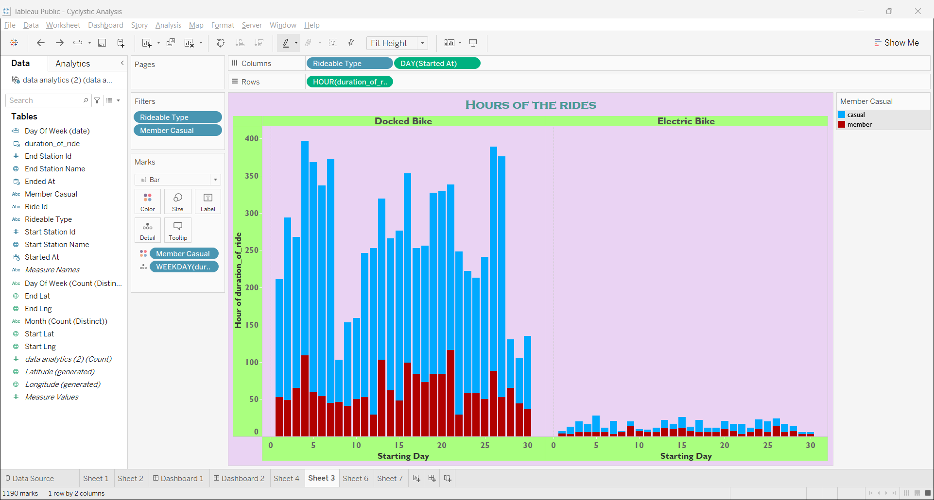
This bar chart visuals shows the duration of rides at the starting day of the week.
This shows the information about the type of bikes used by the members according to their membership.
The tooltip information also included like the total hours of ride, rideable type, membership type.

Slide 7
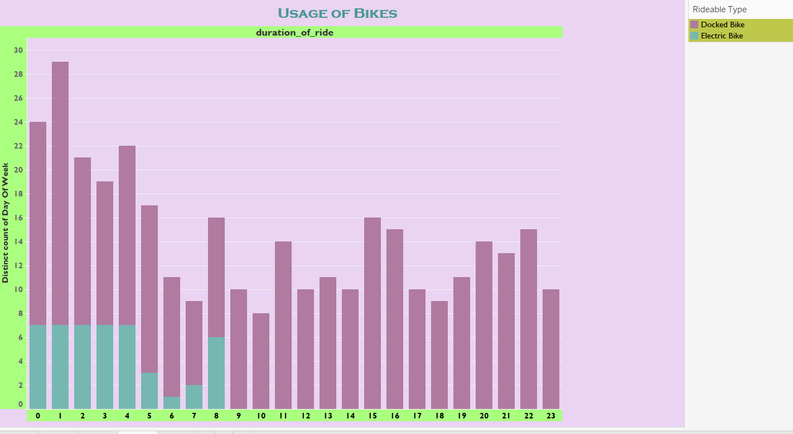
This visual shows the usage pattern of the bikes by the members
By this visual we can understand the preference of the people according to their usage.
We can see that the impact of the electrics bikes are much lesser than the docked bikes.

Slide 8
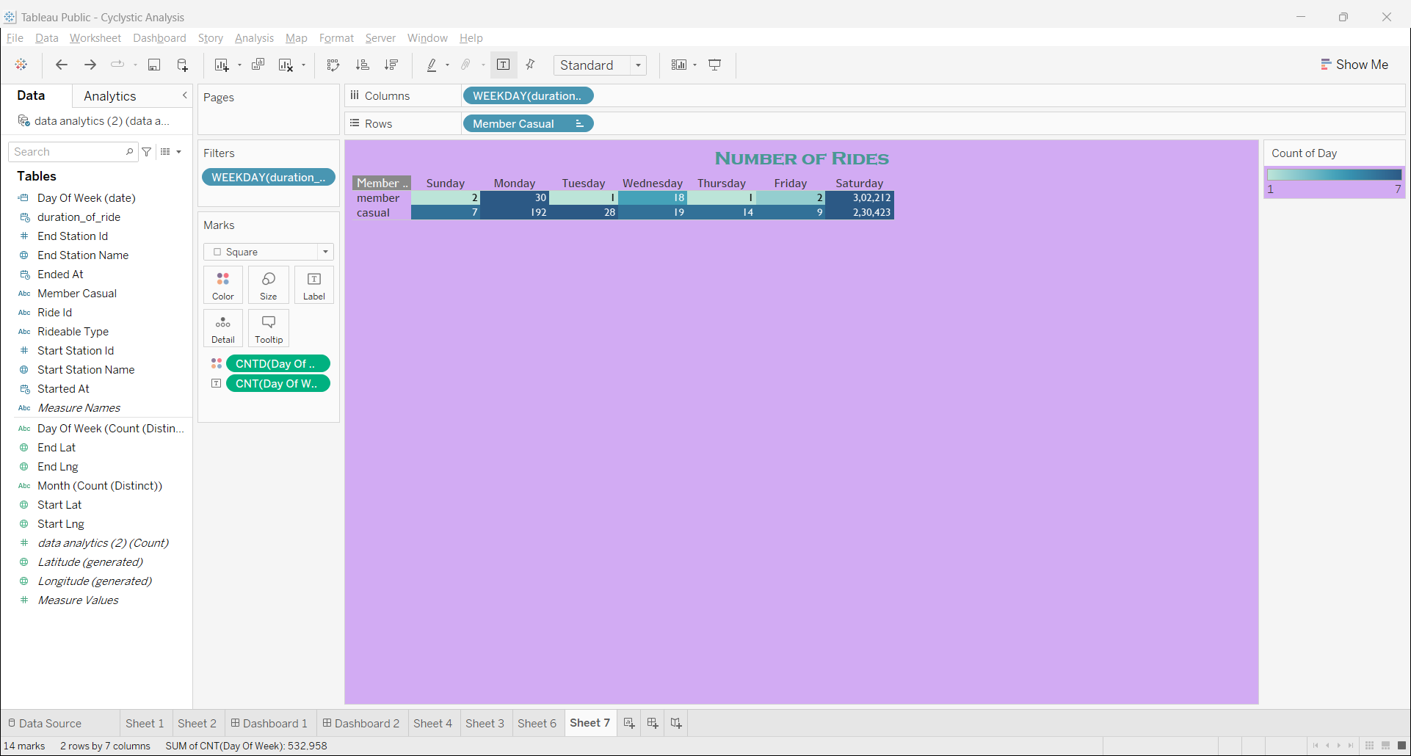
This table shows the frequency of the rides by the members in a week.
This clearly shows how frequently the members are using the bikes for the ride in a day.
The number of rides by the casual type of members are higher than members during the weekends lesser during the weekdays.
The number of rides by the members is also higher in weekends and during the weekdays the usage is high than the causal members.

Slide 9
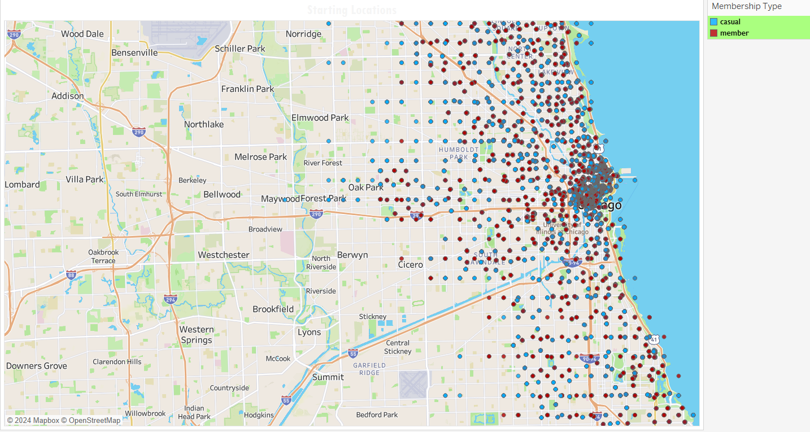
This trip map shows all the ride details of the starting stations and their names of the both members and causal type of members.
The tooltip information included for the additional information about the ride details.
It includes duration of the ride, member type, ride id, start station name and their latitude, longitude, rideable type and the day of week.

Slide 10
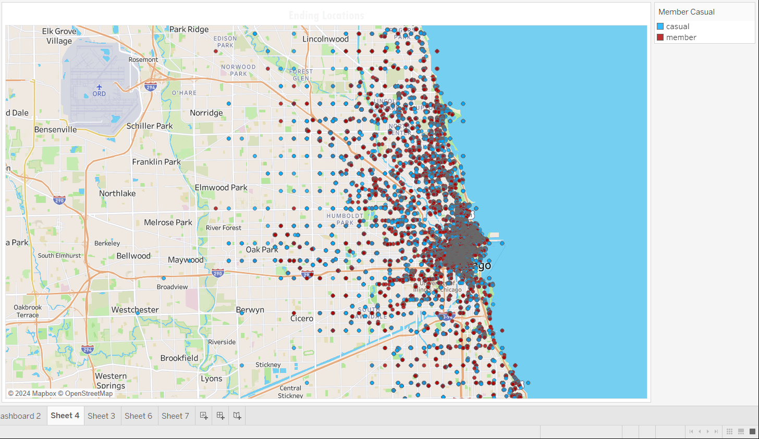
This trip map shows all the ride details of the ending stations and their names of the both members and causal type of members.
The tooltip information included for the additional information about the ride details.
It includes duration of the ride, member type, ride id, start station name and their latitude, longitude, rideable type and the day of week.

Slide 11
Key Insights
Docked type of bikes are most preferred by both causal and member types.
The usage of electric bikes are comparatively low than docked bikes.
Usage of both types of bikes are high in case of the members
In case of casual type of members the usage of bikes, frequency of rides and duration of the rides are higher during the weekend and preferably low during the weekdays.
In case of the members the usage of bikes, frequency of rides and the duration are higher in weekends but less than causal members. In weekdays the usage is average but high than the casual members.
By analysing the trip maps using the starting and ending details the pattern of usage can be predicted.
The casual members take the long rides but less than the members,
The members takes the short rides but frequently than causal members.
The causal members take rides often to the park sides, along the beaches and the restaurant areas which has longer rides.
The members take the rides to the avenues, residential areas and the commercial areas the rides are shorter but frequent.

Slide 12
Recommendations
The usage of electric bikes to be increased by creating awareness regarding advantages of using the electric bikes.
The casual types of members uses bikes more in weekends. The campaigns can be conducted along the recreational areas which can attract the casual members by providing them with the special memberships during weekends.
Since the duration of the rides are shorter in case of members, they can be encouraged to take long rides by giving them attractive discounts.

